Slide 1
Auto _eda
23CS002PC304-AI Assisted Coding
Team Details:
N.Lasya Priya-2303a52129
M.SaiCharani-2303A52192
Department of Computer Science & Artificial Intelligence
SR University
Warangal, Telangana, India

Slide 2
INTRODUCTION
Data analysis is important in modern applications .
Exploratory Data Analysis (EDA) helps understand datasets.
Manual EDA is time-consuming and complex.
Requires technical knowledge and effort .
This project automates the EDA process.
Uses Python-based tools and libraries.
Performs data cleaning and visualization .
Detects missing values and duplicates .
Generates insights automatically.
Improves efficiency and productivity.

Slide 3
PROPOSED SOLUTION
Develop an automated EDA notebook system
User uploads dataset (CSV file)
System loads and processes data
Removes duplicate records
Handles missing values (median/mode)
Generates statistical summaries
Creates visualizations (graphs, charts)
Detects outliers using IQR method
Performs correlation analysis
Saves cleaned dataset for future use

Slide 4
OBJECTIVES
Automate the EDA process
Reduce manual effort in data analysis
Improve data quality through cleaning
Provide quick insights from datasets
Detect missing values and duplicates
Identify outliers in data
Generate visual representations
Support both numeric and categorical data
Prepare dataset for machine learning
Increase productivity of users

Slide 5
STAKEHOLDERS
Data Analysts – analyze datasets quickly
Data Scientists – prepare data for models
Students – learning and academic use
Developers – integrate into applications
Project Managers – decision making
Businesses – faster data insights
Researchers – efficient data analysis
Organizations – improve productivity
QA Teams – validate data quality
End Users – benefit from accurate results

Slide 6
PROGRAMMING LANGUAGES, TOOLS & SOFTWARE
Python – main programming language
Pandas – data manipulation
NumPy – numerical operations
Matplotlib – data visualization
Seaborn – advanced plotting
Missingno – missing data visualization
Jupyter Notebook – development environment
VS Code – code editor
Git & GitHub – version control
Pip – package installation tool

Slide 7
LIST OF PROMPTS USED TO COMPLETE THE PROJECT
Generate Auto EDA notebook using Python
Load dataset from CSV file
Perform data cleaning automatically
Handle missing values using median/mode
Remove duplicate records
Create histograms and bar charts
Detect outliers using IQR method
Generate correlation heatmap
Summarize dataset insights
Save cleaned dataset

Slide 8
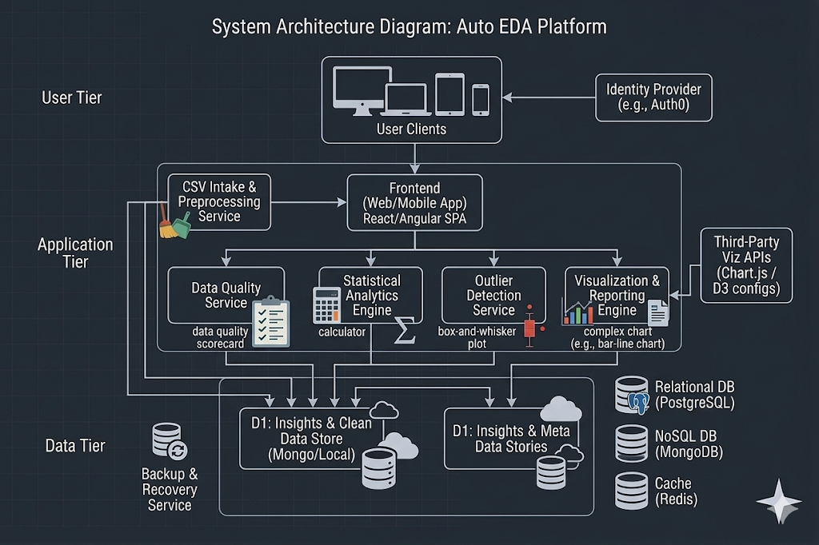
FLOWCHART OF THE WORKFLOW
SYSTEM ARCHITECTURE:

Slide 9
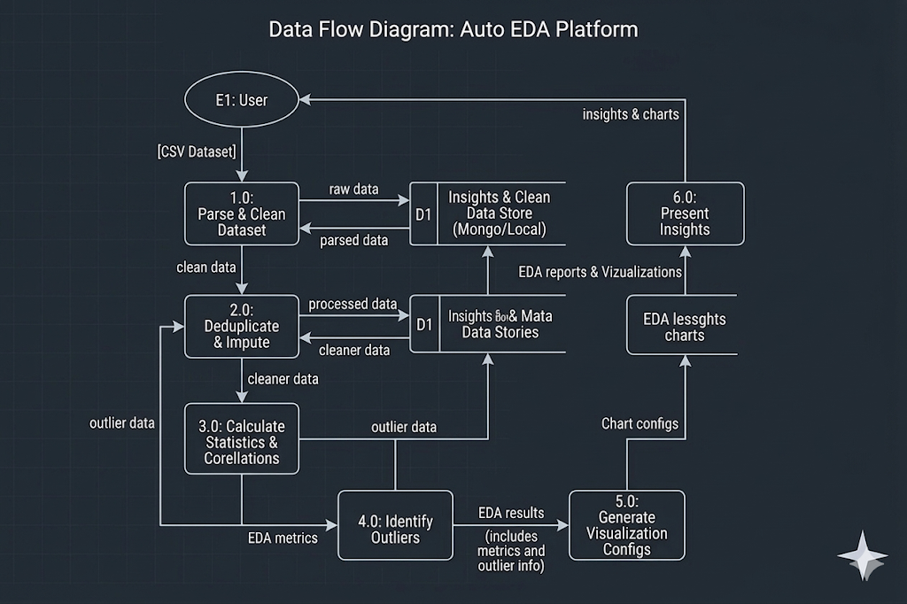
DATA FLOW DIAGRAM

Slide 10
FRONT-END VIEW OF WEB/MOBILE APPLICATION
Simple and user-friendly interface
Login/Signup page for authentication
Dashboard with dataset upload option
“Upload CSV” button or drag-and-drop feature
Dataset preview after upload
“Analyze” button to start EDA
Displays charts, graphs, and insights
Option to download cleaned dataset
Responsive design for web and mobile
Easy navigation with clear UI elements

Slide 11
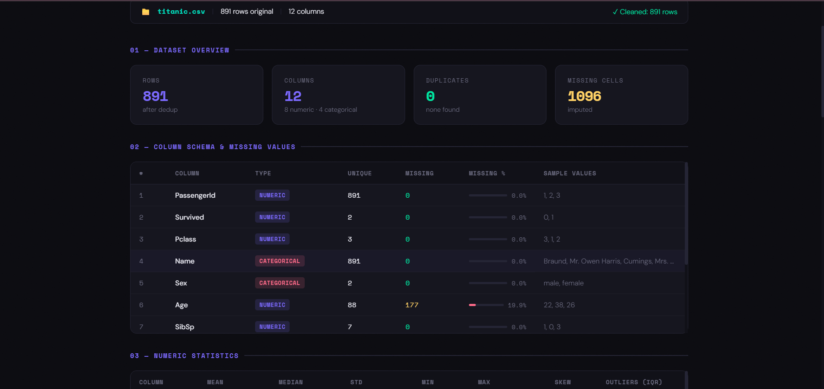

Slide 12
REFERENCES
Pandas Library Documentation
NumPy Library Documentation
Matplotlib Visualization Library
Seaborn Statistical Visualization Library
Missing no Library for Missing Data Visualization
Python Programming Language Documentation
Jupyter Notebook Environment
Kaggle Dataset Repository
Scikit-learn Machine Learning Library
Research papers on Exploratory Data Analysis and Data Preprocessing

